Slide 1


Slide 2
What is Pygame?
Pygame is an open source, cross-platform, community developed module designed for writing video games through the use of Python. Pygame was designed to alleviate the worry of backend complexities, including libraries for graphics and sounds. Being built on top of the development library Simple Directmedia Layer, Pygame is highly portable.

Slide 3




Why Pygame?
Portability – Can be accessed across multiple OS
Ease of use – Graphics library designed to abstract from game logic.
Large community – Active community with multiple forums to ask and receive help from in a timely manner.
Written in python – Who doesn’t like writing in python!

Slide 4
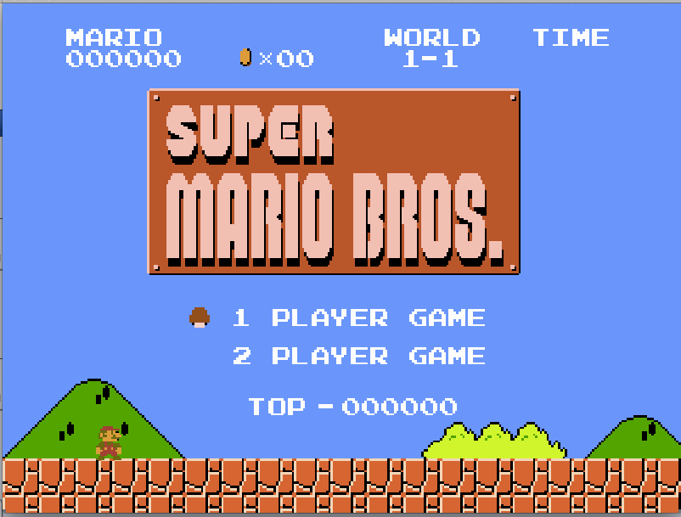
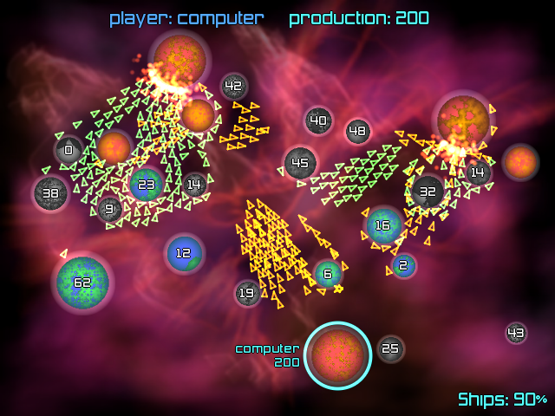
Examples of Games
http://www.galcon.com/classic/index.html
https://github.com/justinmeister/Mario-Level-1

Slide 5
Pygame Limitations
No iOS support
Tends to be inefficient – Due to game logic performing graphic and sound functions
Wonky Hitboxes - All Pygame sprites have an invisible rectangle they’re encased in and it’s centered left. Requires extra coding and manipulation to tailor to your specific needs.
Can’t create more than 2D games

Slide 6
Content and links
https://www.pygame.org/docs/
https://www.pygame.org/news
http://www.libsdl.org/

